Slide 1
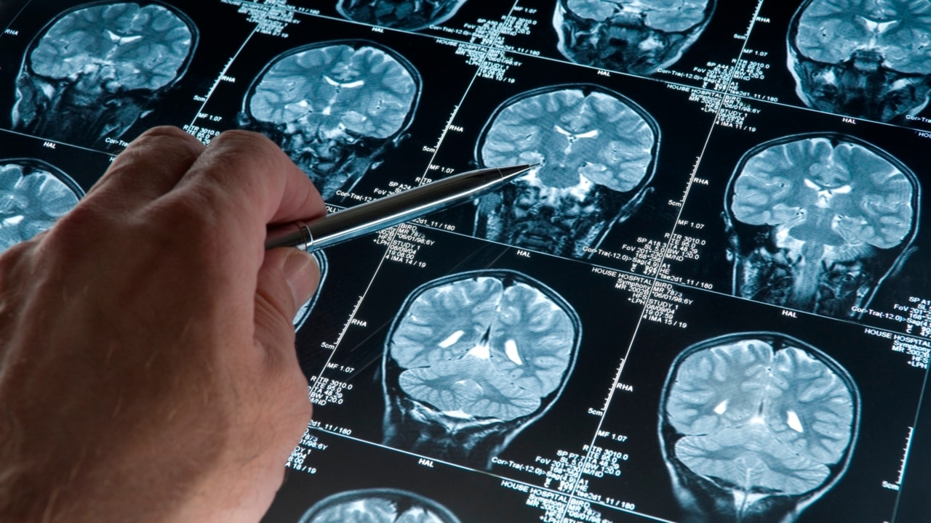
PARKINSON DISEASE DETECTION USING MACHINE LEARNING
Presented by,
Rahul B (510620104062)

Slide 2
CONTENTS
ABSTRACT
INTRODUCTION
PROBLEM STATEMENT
PROPOSED WORK
SYSTEM ARCHITECTURE
MODULE EXPLAINATIONS
CONCLUSION AND FUTURE WORK
SAMPLE OUTPUT SNAPSHOT

Slide 3
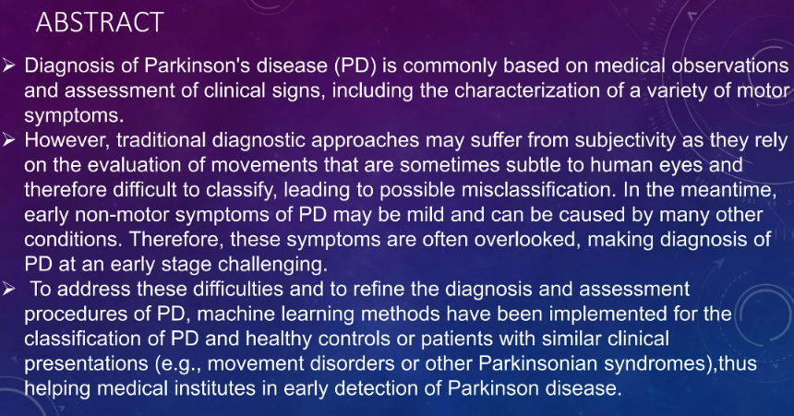

Slide 4
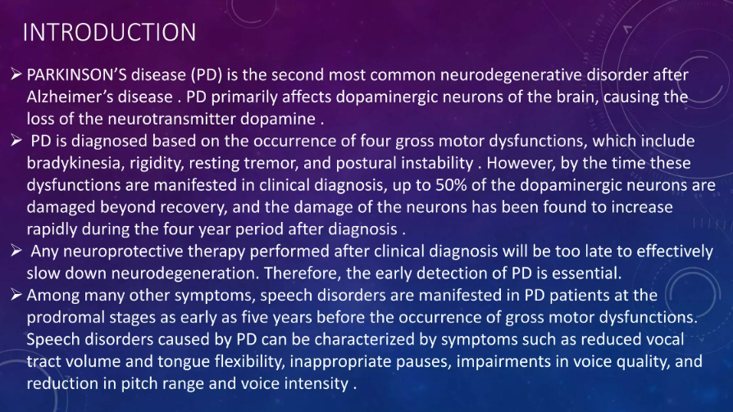

Slide 5
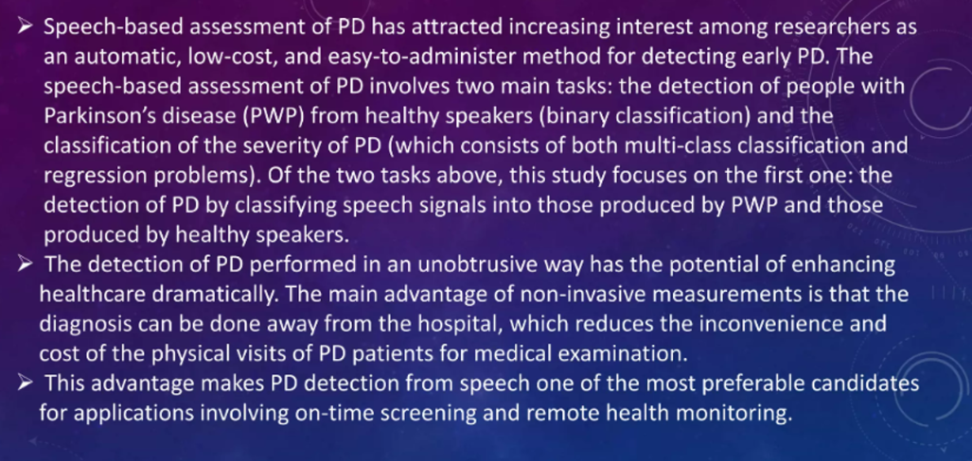

Slide 6
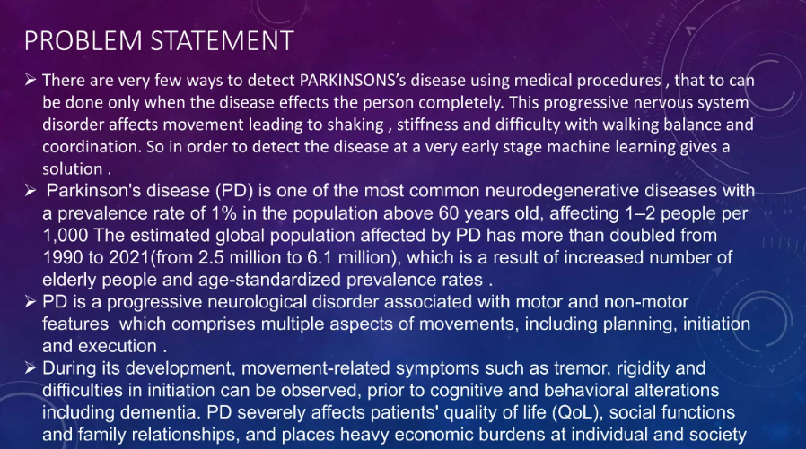

Slide 7
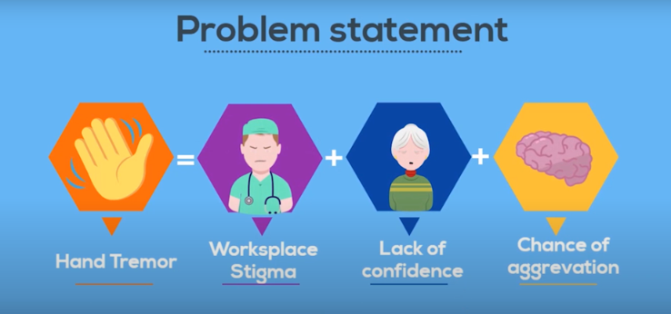

Slide 8
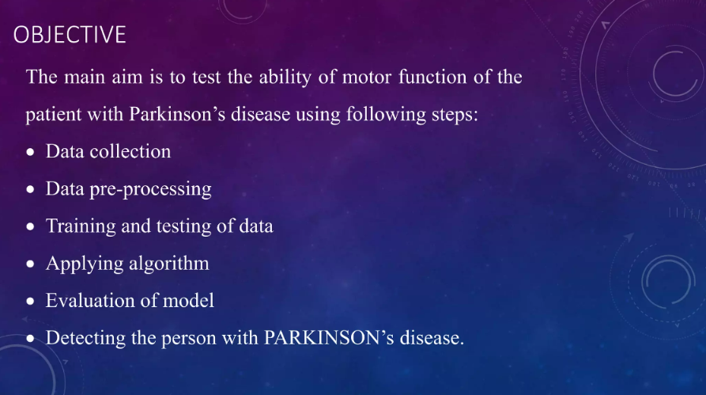

Slide 9
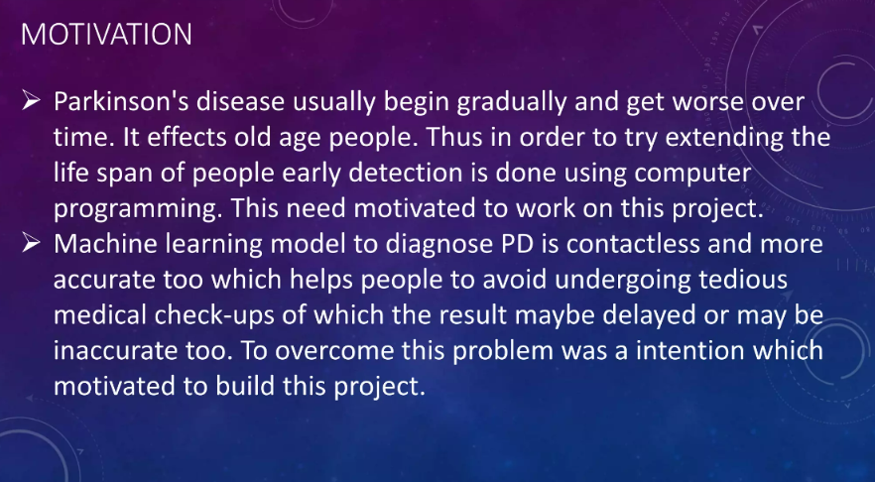

Slide 10
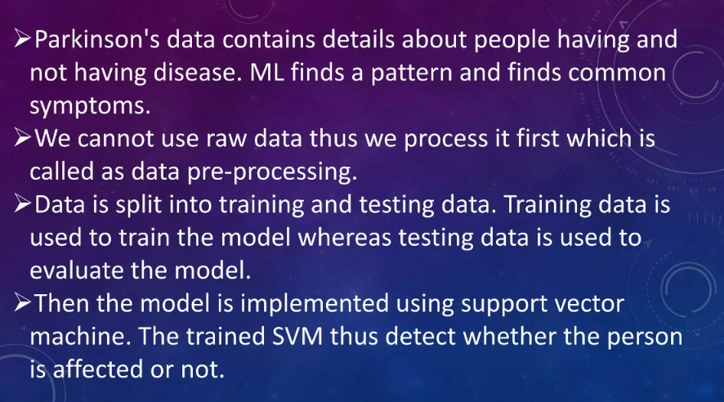

Slide 11
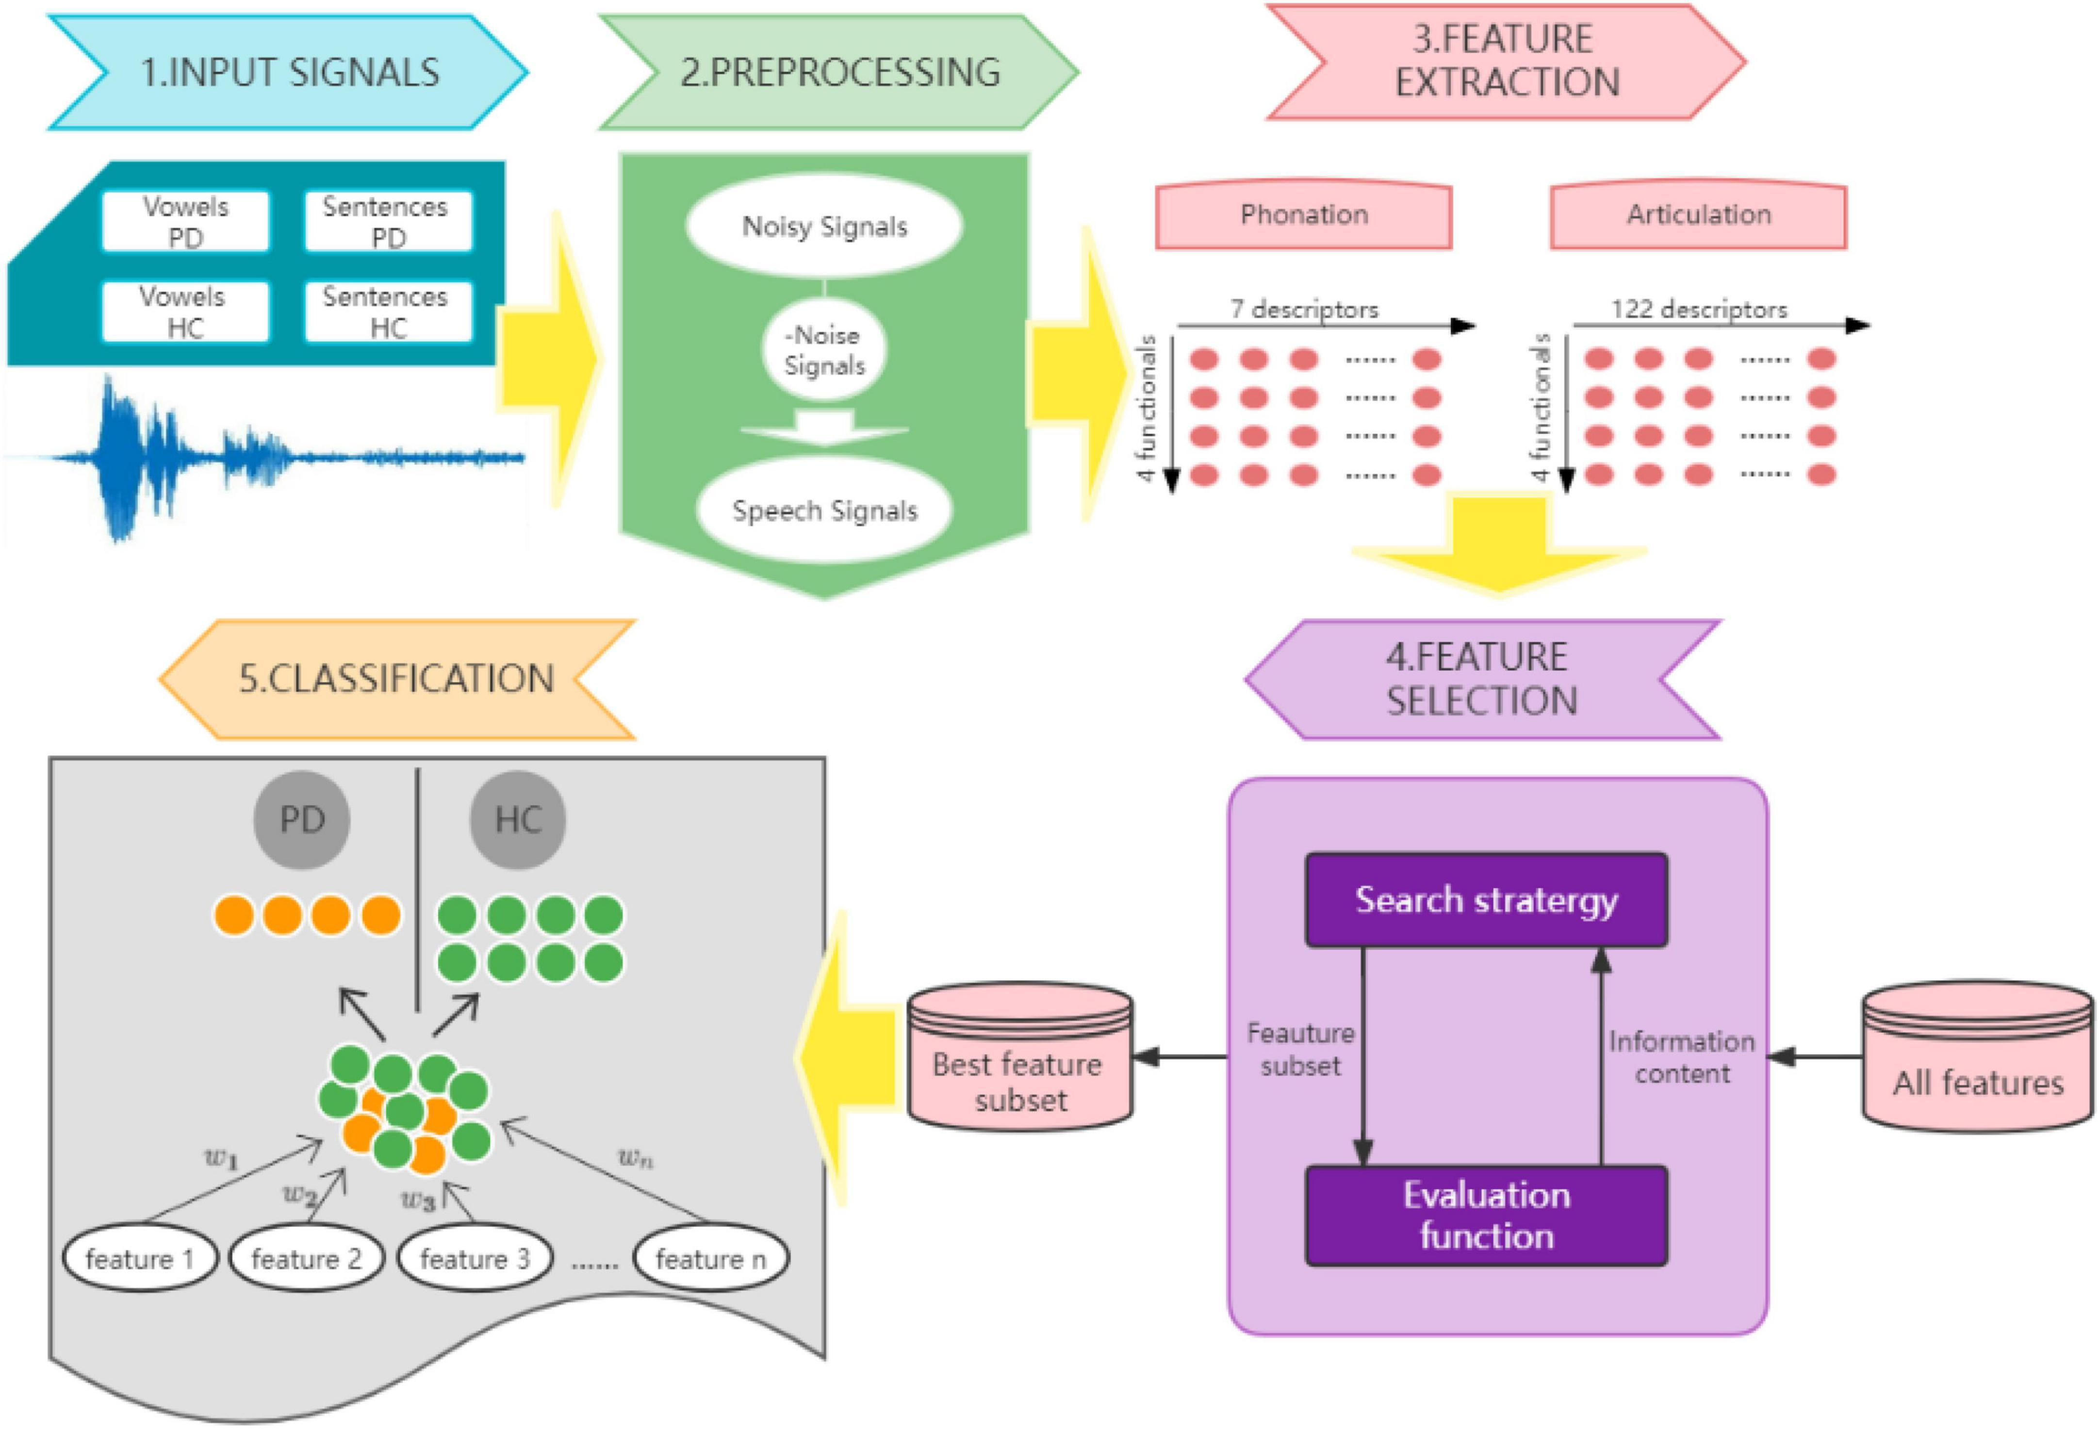
PROPOSED WORK
SYSTEM ARCHITECTURE

Slide 12
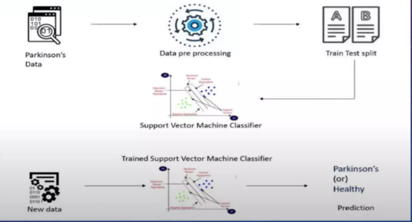
MODULE EXPLAINATIONS

Slide 13
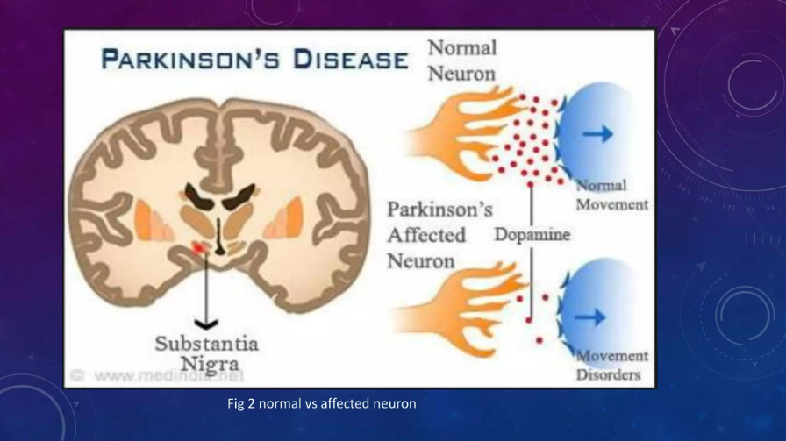

Slide 14
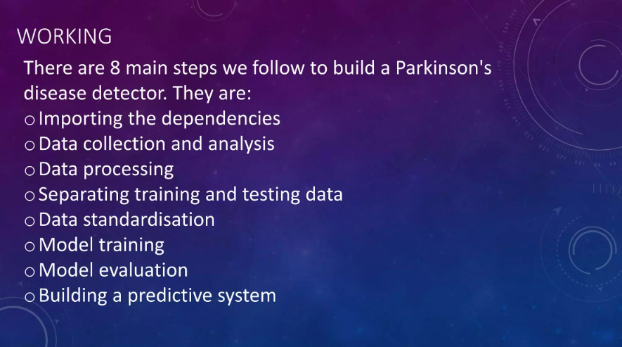

Slide 15
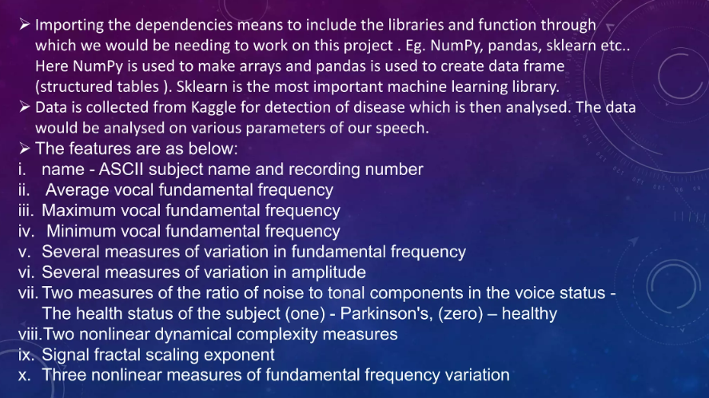

Slide 16
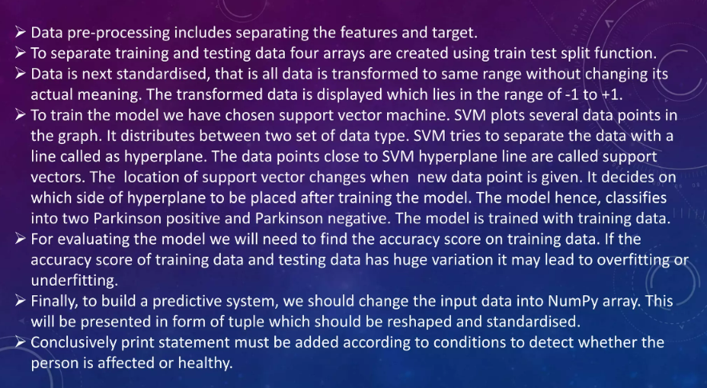

Slide 17
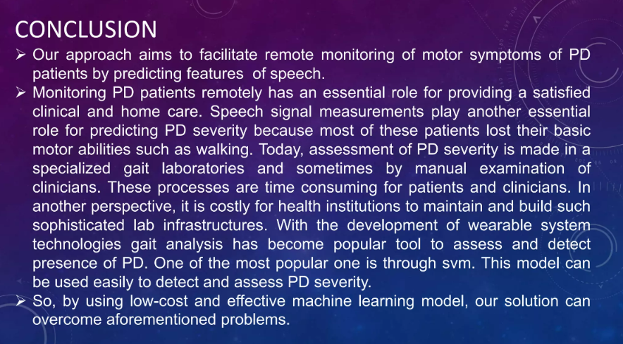

Slide 18
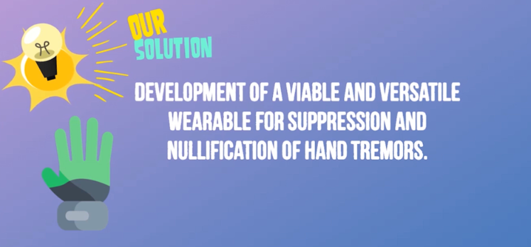
FUTURE WORK

Slide 19
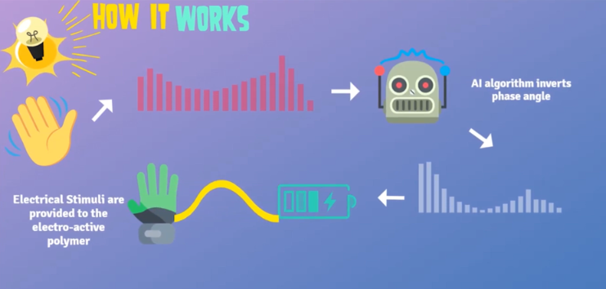

Slide 20
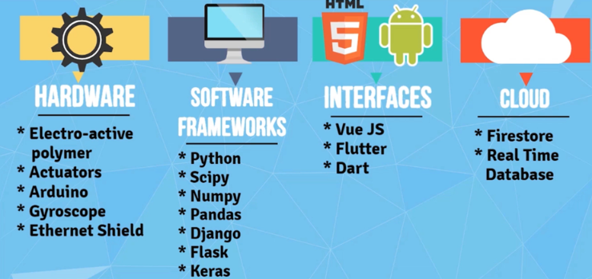


Slide 21
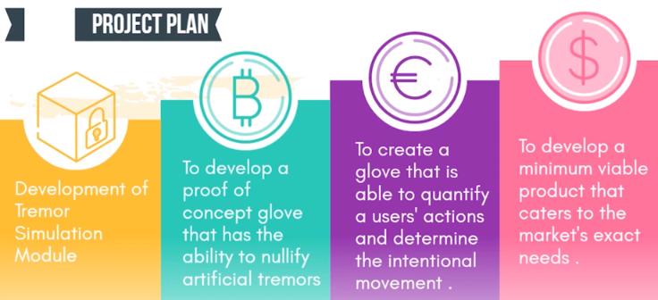


Slide 22
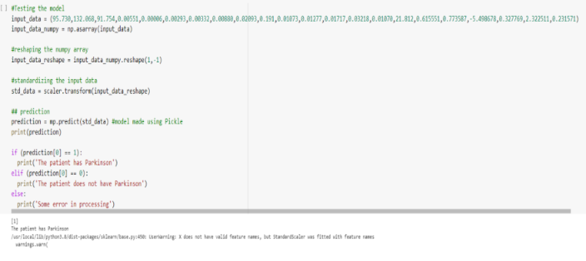
OUTPUT SNAPSHOTS

Slide 23
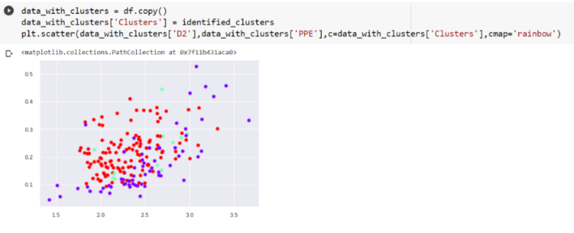
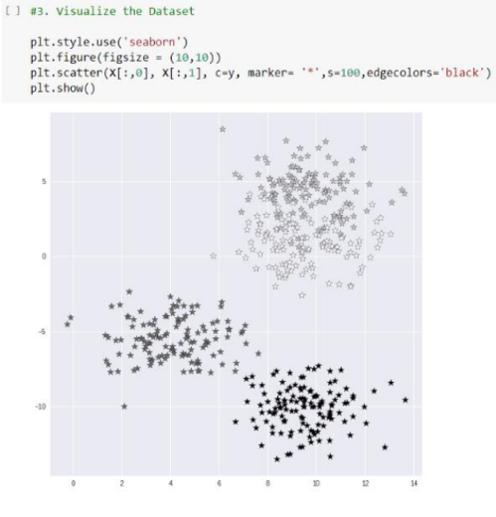
SVM PREDICTION PLOT
KNN PREDICTION PLOT

Slide 24
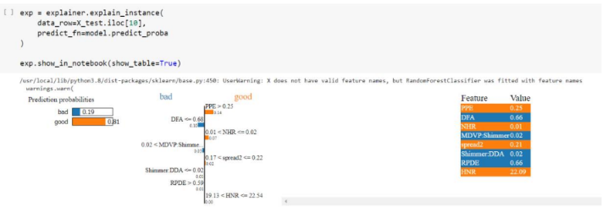
EXPLAINABLE AI

Slide 25
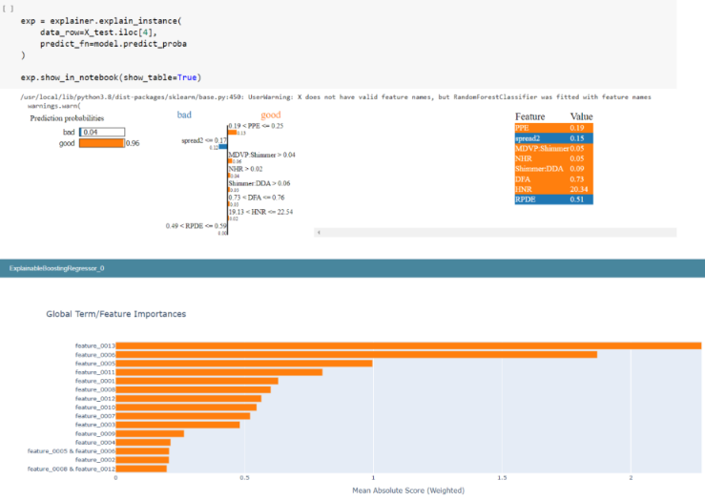

Slide 26
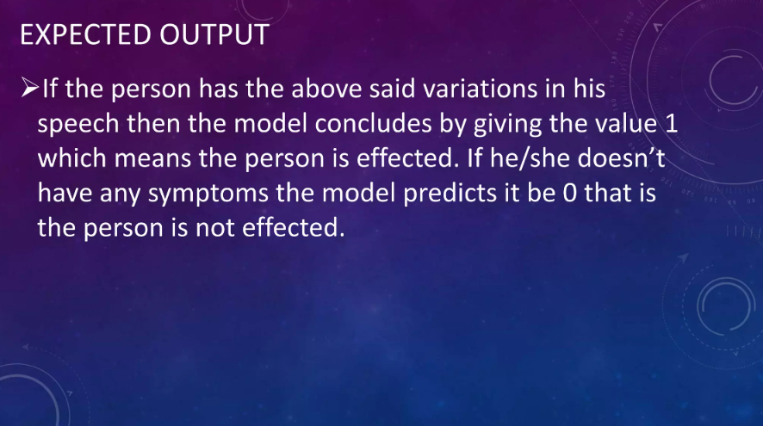

Slide 27
THANK YOU !!!

